Slide 1
MemComb Sprint 3
Bassam Thomas
Danny Naum
Chris Stidham
Scott O’Neil
Nathan Hyde
David Michon
Jacob Couveau
Notes:
David

Slide 2
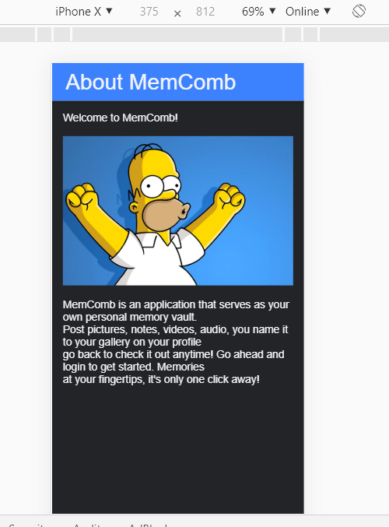
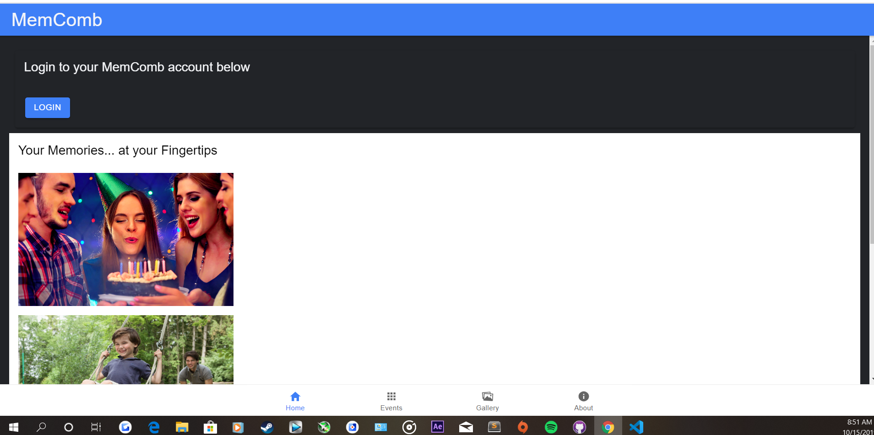
Landing and About page

Slide 3
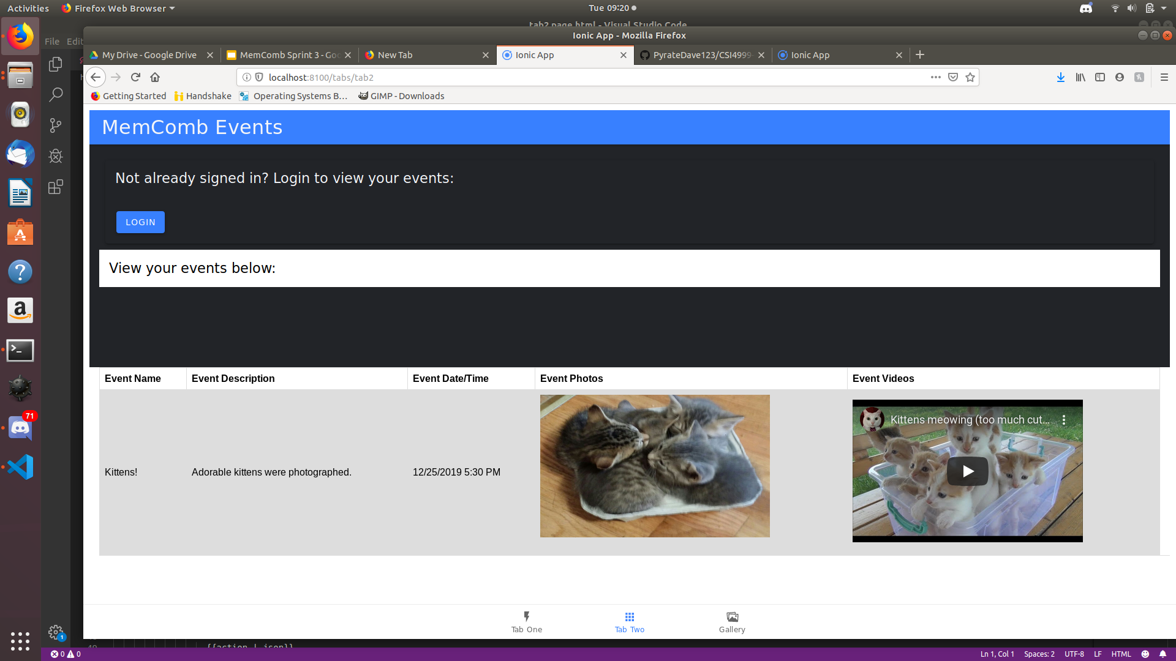
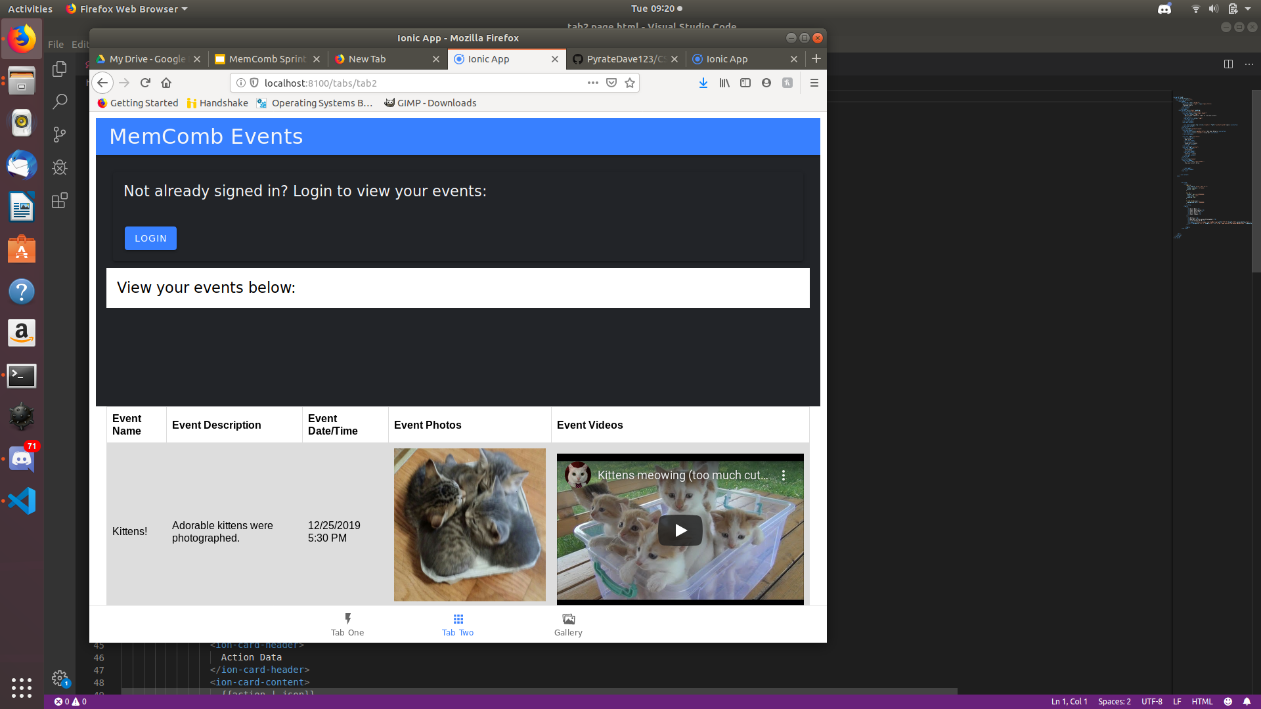
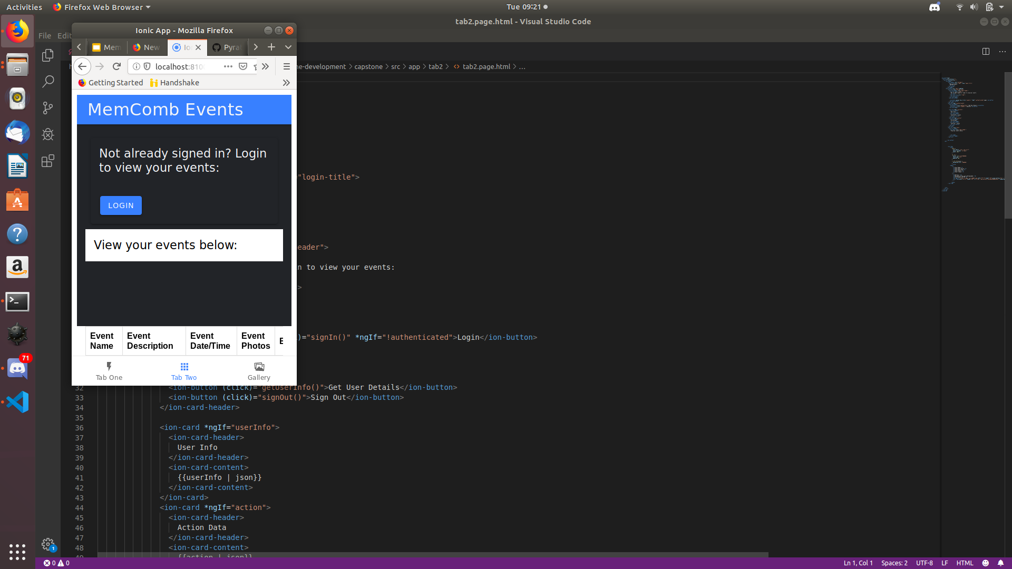
Events Page Grid Implementation

Slide 4
Risks and Challenges
Integrating the database
Making the app scalable for the desktop and app versions
Implementing the events that will store the audio/video/text files
Connecting different users based on similar stored items
Scraping Google search results

Slide 5
Demo
Notes:
David

Slide 6
Looking Forward
Next Sprints goals:
As a user, I shouldn’t be able to go to other tabs before I login
As a user, I should have a clean profile page to see my personal info
The system shall have a database hosted in Google Firebase
The system shall differentiate users in Firebase via Okta integration
Notes:
David

